Slide 1


Starting out with Python
W200 Introduction to Data Science Programming
Week 02
version: Jan 6, 2020

Slide 2

Agenda
Checking in for last week; my questions
Running Python
Expressions
Objects
String Objects
Control of Flow
Breakout Activities (several)

Slide 3

Checking in …
Are your environments set up okay?
Homework assignments are posted on GitHub … upstream on Monday evenings.
TA grade and provide feedback; Instructors may review; grade & provide feedback on projects.
Make sure you’re using Python 3.x (3.6 or 3.7). We ask that you don’t (yet) use PyCharm of Spyder.
GitHub ready to go? Ask Rob for help.
Bash info: [http://hyperpolyglot.org/unix-shells]
Resources

Slide 4
Where to go with questions?
Near Real-Time Help:
Communication to instructors & other students: w200-python-2020-spring@googlegroups.com
Communication with instructors only: mids-python-instructors@googlegroups.com
Slack Channels for information communication: ucbischool.slack.com channel #w200-python
Extra “Live” Help:
Three instructor-led office hours each week (3-hours of personalized instructor time) See Syllabus.
One dedicated TA-led office hour each week (+1 more hour of personalized time); contact Mark B.
Extra “Practice” With Solutions:
Drills, with answers!
Q&A from breakouts (posted to assignments_upstream)
Course Syllabus, with all Async Notebooks! https://github.prod.oc.2u.com/UCB-INFO-PYTHON/Course-Syllabus
Homework solutions (posted within 1-week to assignments_upstream)
Other Classmates:
Introductions show students with a vast range of experience in data science, analysis, programming … just as in medicine we “see one, do one, teach one” - so it is here - share your experiences.

Slide 5
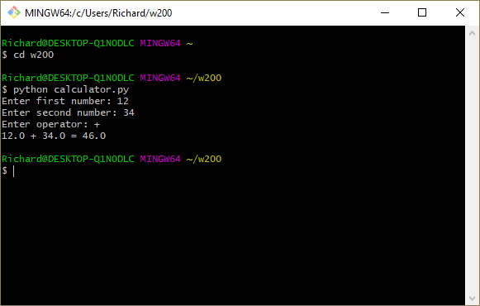
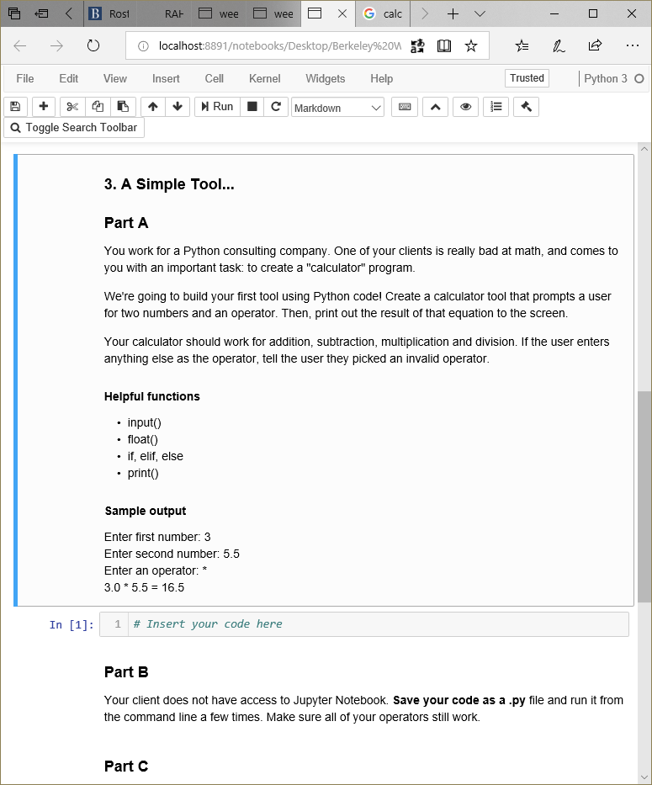
Running Python (reminder)
Command line Use a text editor [Atom, BBEdit, NotePad++; and save as a .py file. You may need to specify >python3 myfile.py if you have multiple versions installed.
Jupyter Notebook App that interprets and provides error msgs. Useful for testing - be sure to reload variables and remember that instructors don’t have access to your hard drive.
Check out Jupyter Notebook in class; PyCharm & Spyder websites

Slide 6
Expressions
Assignment |  | x = 5
Addition | + | x + 5
Subtraction | - | x - 5
Division | / | x / 5
Multiply | * | x * 5
Exponent | ** | x ** 5
Cumulative | += | x += 5 x = x + 5
Equivalency |  | x == 5
Cumulative | -= | x -= 2
Integer division | // | x // 5
Modulus | % | x % 2

Slide 7
Objects
What is an “object” - a programmatic way of expressing things in the physical world* of the time you’ll have to discover answers on your own (that’s how it is in computing).
For OOP languages - the “object” is the parent, from which child objects are copied and used; these child copies are the instantiation of the Object. In coding the “Object” becomes a “Class.”
Objects (a) contain all their variables and behaviors [methods] [encapsulation], (b) can accept multiple parameters [polymorphism], and (c) can be copied and new properties added [inheritance].
Objects aren’t necessarily linear: they can send messages to/from each other, given appropriate triggers.
In OOP there’s a hierarchy of libraries; going up the chain of a command leads ultimately to the base Object; from there we can traverse a chain back down to another type of object (hence “type-casting”).
Rather like Plato’s Theory of forms, De re publica, Book 10.

Slide 8

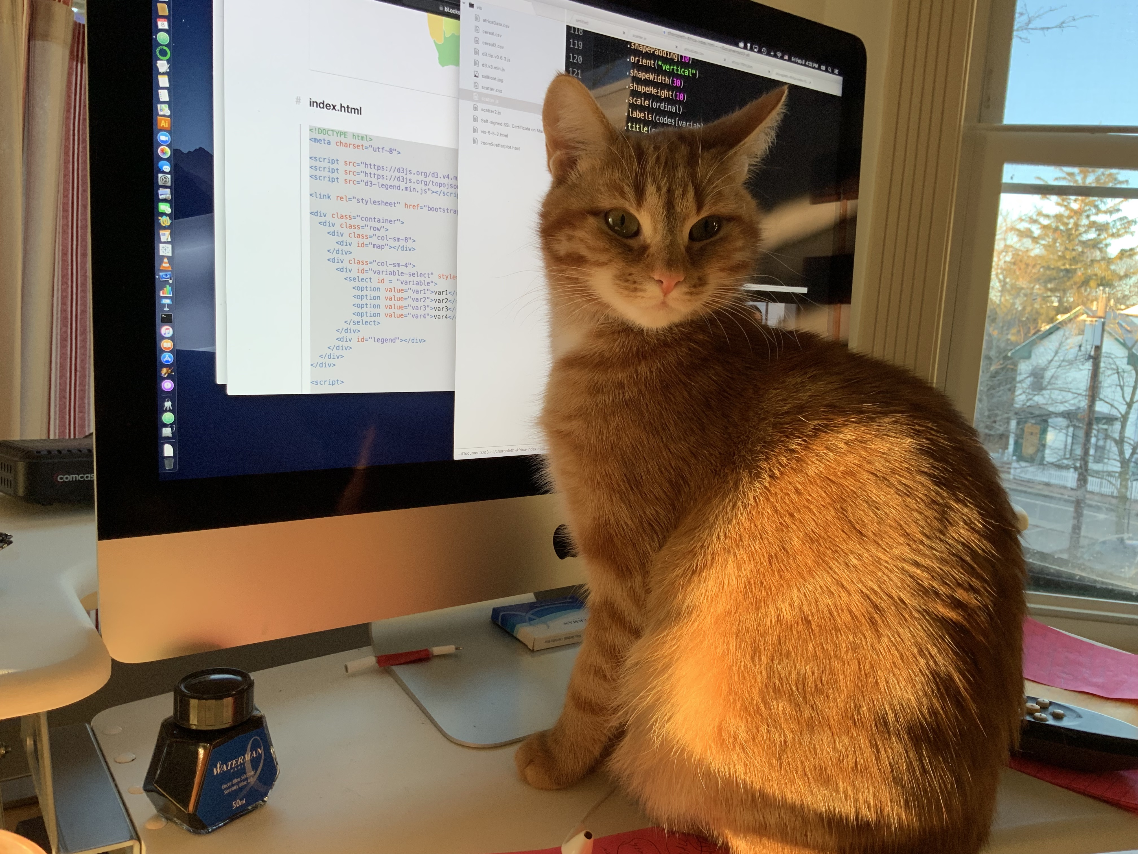
Objects

Slide 9
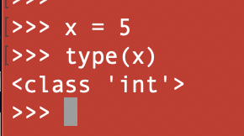
Objects: Types
Python lets us assign values (as all languages do) and we can test what data type we’re using, e.g., x = 5 → type(x) → returns int
Boolean [bool, true/false; 0/1]
Integers (int) counting numbers
Floating point (float), e.g., 3.14159
String (str), a sequence of contiguous characters referenced by the first character’s address in RAM
Type cast: convert data from one type to another, e.g., float(x)
st = input(“Enter some text:”) #Default is string
fl = float(input(“Enter data:”)) #Convert to float

Slide 10



Variables go into a special object called a “name space.” Think of “scope & visibility” of vars and how they’re accessed in the code.
vari-able
name space
object space
var
name space
object space
x
x
5
int
b_int
b_int
36
file
c_int
c_int
int
But without a namespace we can’t reach elements in the object space
greet
greet
print(“Bonjour”)
function

Slide 11
String Objects
A string is a “sequence object” [imagine the memory address of this string is 0 and is n bytes long. - Locate entire strings, individual letters, range of letters]
Strings can be joined (or “concatenated”) and manipulated:
concatenation: “cat” + “dog” outputs “catdog”
multiplication of chars: “-”*10 outputs —————
<string>.upper(), e.g., x = “cat” print(x.upper())
<string>.lower()
s = input(“Type here:”)
s_cast = input(str(“Cast to string:”))
Python gains a lot of speed by using “pointers” and like many languages, the pointers are hidden from the programmer. [No issues of malloc and referencing points!] Notice that as an OOP language, Python often uses String methods (hence the . and ()) to copy, adjust, and then replace the object in RAM, using the same variable name.

Slide 12
Optional: A side note.
RAM (random access memory) looks like a “screen door.” Every wire on the x-axis that crosses the wire on the y-axis creates a memory address. There are two registers: address and data.
The data are stored by being encoded and decoded (pointers and dereferencing pointers; may include casting object into other data type, often as String).
So … when a Python variable (object) is stored in RAM, our variable “point” to the object’s memory address in RAM. A copy of the variable has a different name but still points to the same memory address. This is important.
If we have a = 5 and then b = a, both a and b refer (point) to the same memory address. Consequently, changing the value of “b” changes the value of “a”.
This might cause a problem in your coding. We’ll see this addressed in the idea of “scope and visibility” of our variables and in certain Python commands, such as copy versus deepcopy.
(But it is cool how our code is so intimate with the chip!)
Strongly recommended: read
Sipser, M., Introduction to the theory of computation. (3rd ed). A pdf earlier version is here.
http://www.righto.com/2017/07/inside-intels-first-product-3101-ram.html

Slide 13
String Objects
Yikes, those darn single- and double quotes!
Python, like other loosely-typed languages allows using single- and double-quotes around Strings. Keep in mind that often when concatenating data we use a mix of “ and ‘ … the use of these must be balanced, else a hard to find error.
Comments in python code use three “, e.g., “””
\ means an “escape sequence”, note: \n, \r\n, \t
' ' # single quotes (the dagger kind)
" " # double quotes (notice the pairing)
t = input("Welcome, you're here! ")
# double quotes surrounding string
# so the single quote is safe
s = input('Welcome, you\'re here!’)
# single quotes, so middle one needs
# to be "escaped"

Slide 14
String Objects: Slicing
p
y
t
h
o
n
!
0
1
2
3
4
5
n
[0] | from the start of the string
[-1] | one letter from the end of the string
[0:3] | from the start of the string to the 4th letter
[1:-1] | from 1 to the next to last letter
[1:5:2] | from 1 to 5, by 2 at a time
[:-1] | beginning (:) to second to last letter (n - 1)
[:] | entire string
[::-1] | entire string, reversed
“Slicing” is surprisingly
important in data sci and
processing of data,
during “data cleansing.”
We rely in splicing to test data
before ingesting, to test data
for certain conditions …

Slide 15

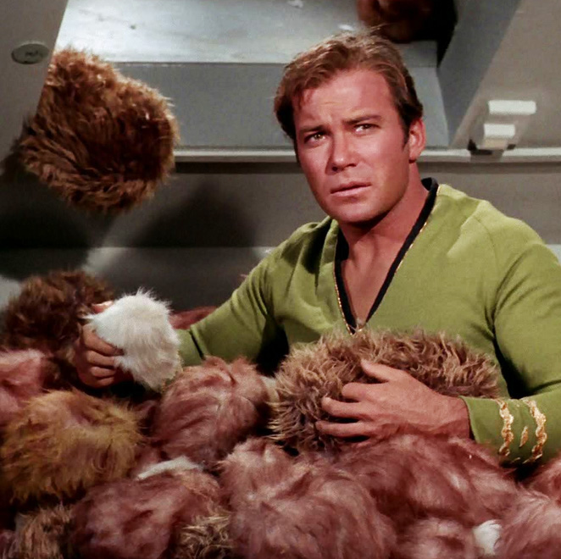
Breakout Activities:
1) Tribbles, 2) Spiders, and 3) Calculator
Fire up what you downloaded for week 2 in Jupyter and create a string variable that prints exactly
Using one line of Python code, slide your variable from part 1 to print “selbbirT” 300 times.
The “trouble with
Tribbles” is that they
\\\EAT/// too many MREs.
Okay, we’re nerds who like StarTrek! And we’ll drop into your breakout rooms for Q&A.
selbbirT selbbirT selbbirT …

Slide 16


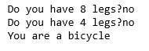
Breakout Activities: Tribbles & Spiders
https://www.youtube.com/watch?v=DVAkVwy4TD4

Slide 17


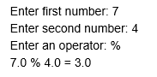
Breakout Activity: calculator
Make a calculator - the purpose is to practice conditions (“if” statements) and saving your work as a .py and executing it.
https://www.clayallsopp.com/posts/definition-of-design-terms/

Slide 18

That’s it!
That’s it! Enjoy a great week and keep up with your drills and homework assignments.

